Slide 1
MeloYelo Training Module 1
Hub Motor E-bike system components:
Location, Appearance and
Function

Slide 2
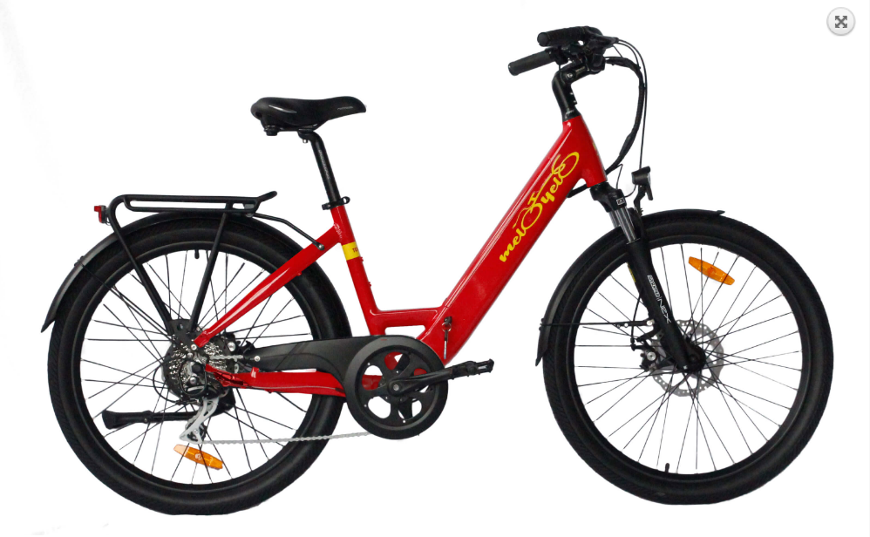
Hub Motor Ebike Components
Display & control buttons
Throttle
Brake lever switches
Battery in Frame
Motor
Torque or Cadence Sensor
Controller (Inside Frame)

Slide 3
Connection Diagram
Throttle
Battery
Buttons
36 (or 48) V DC +/-
Motor
Controller
Display
DC to Display, Comms
2 Brake Lever Switches
3 motor phases,
3 Hall Sensors
5Vdc Supply
Speedo Sensor
Torque or Cadence Sensor
Note: On some controllers, Throttle and Brake Lever Switches connect directly to Controller.

Slide 4
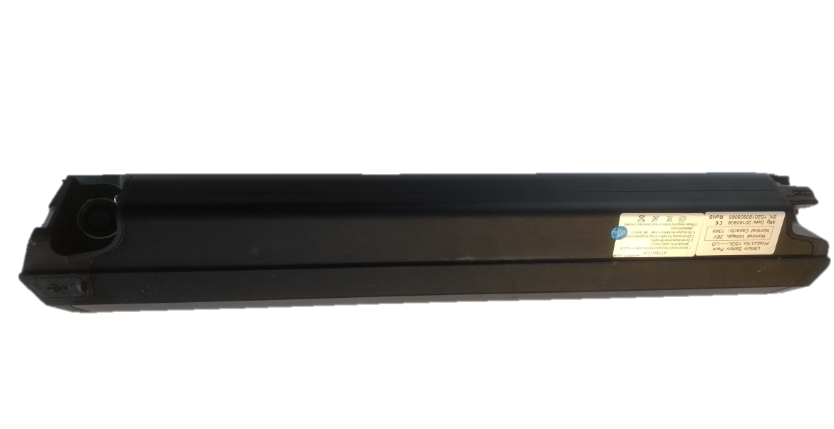
Battery
Function: To store electrical energy supplied by the charger, and deliver it to the controller when the system is turned on. There may be a key switch or physical switch, or simply an electronic “switch” in the controller.
Made up of Lithium Ion cells connected in series to provide the required voltage.
Contains a Battery Management System to ensure that all cells are charged to the correct voltage and battery cannot be overcharged or drained too far.
Roam Battery:

Slide 5
Controller
The Heart of the System.
Function: To accept power from the battery;
To supply low voltage DC to Display, Motor Hall Sensors; Torque / Cadence Sensor, speed sensor and lights;
To receive and interpret signals from Display, Torque / Cadence Sensor, Throttle, Brake Lever switches, Speed Sensor and Motor Hall Sensors, and supply appropriate power to the motor windings as 3 Phase AC.
Continued next slide

Slide 6
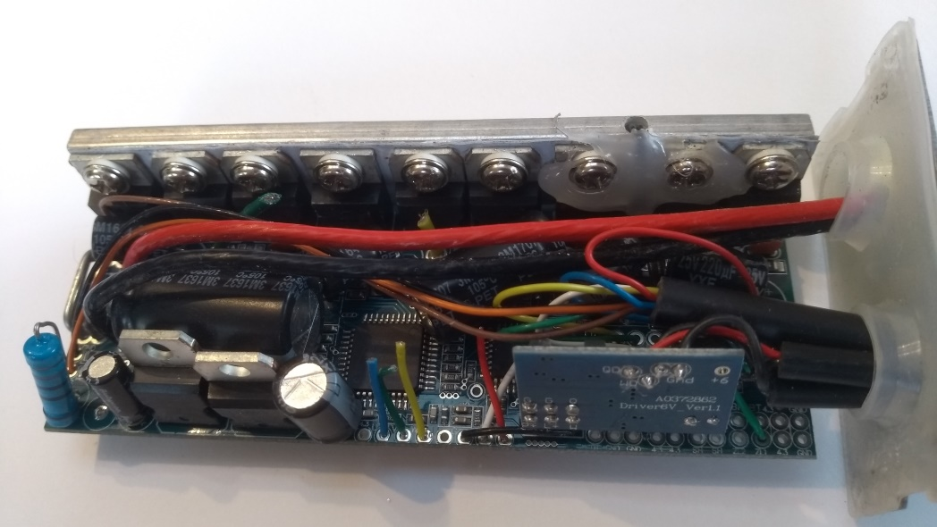
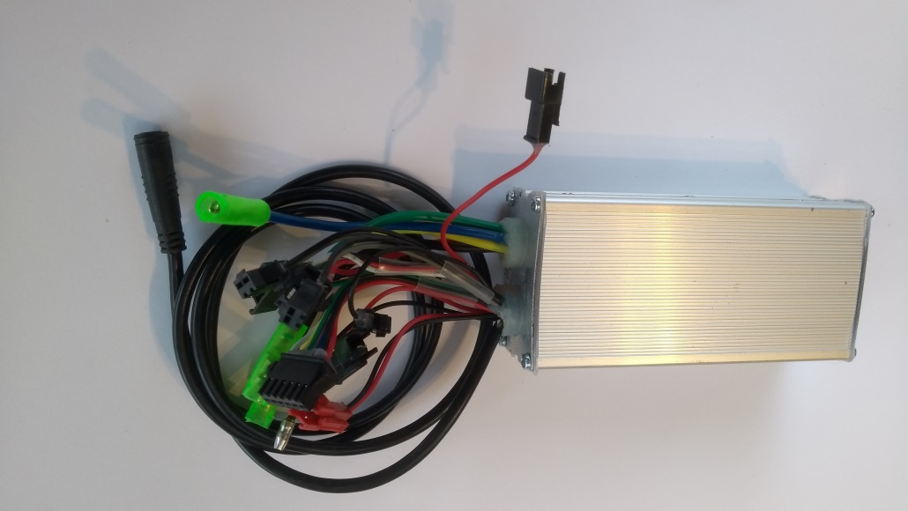
Controller (continued)
To store the program that has been loaded, to determine how many assistance levels there are, power characteristics in each level, maximum speed, wheel size etc
External View
Internal View

Slide 7
Controller Programming
Things like Wheel Size and maximum assisted speed can be set using menus on the Display, but if we connect a computer to the controller we can alter many other settings, such as:
Power applied at each assistance level;
The maximum assisted speed in each assist level (Cadence sensing only);
Ramp-up rate (How quickly the power builds up when the assistance starts);
The balance between Cadence Assist and Torque Assist in each level (Torque sensing bikes only)

Slide 8
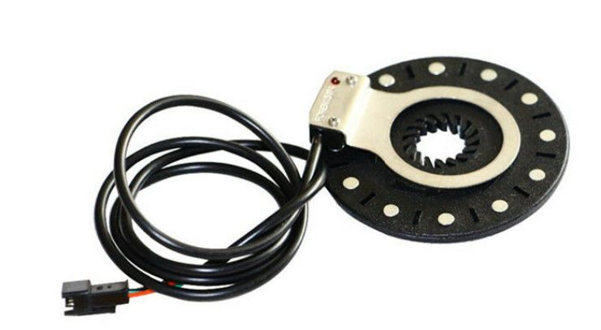
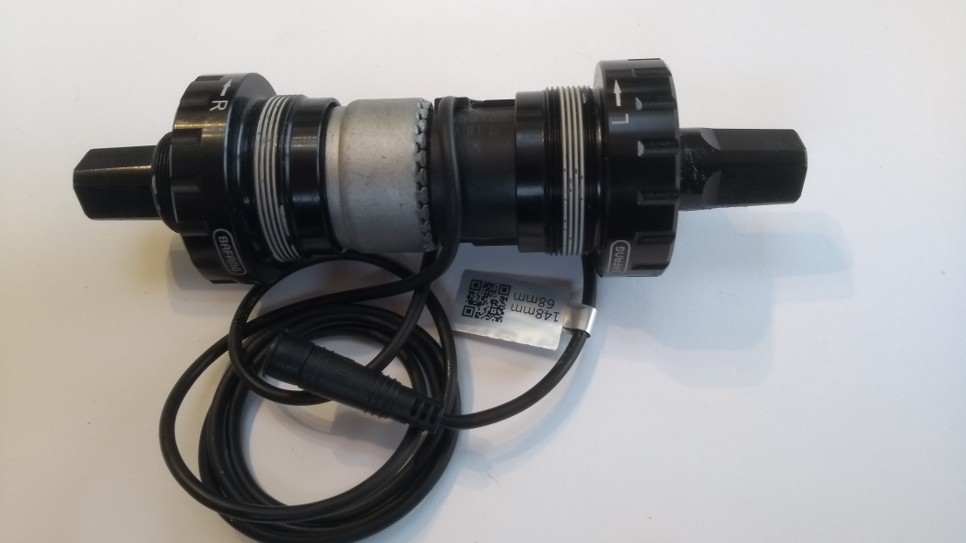
Cadence / Torque Sensor
Both sensor types send information to the controller about when the rider is pedalling, how fast the pedals are turning, and in which direction.
In addition, the Torque sensor sends information about how hard the rider is pedalling.. How much force is being put on the pedals.
Cadence Sensor
Torque Sensor

Slide 9
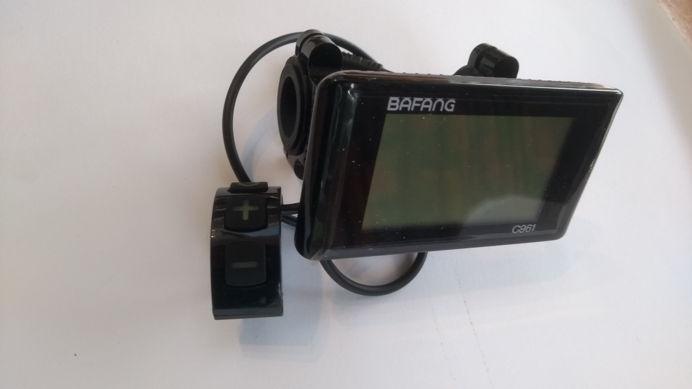
Display & Buttons
Function: To display Speed, Assistance Level currently selected, Battery State of Charge etc,
To allow the rider to input commands to turn the system on / off, change assistance level, turn lights on / off etc,
To allow basic parameters (e.g wheel size) to be changed.

Slide 10
Brake Lever Switches
Whether Hydraulic or Cable operated brakes are fitted, both brake levers have electric switches built in to send a signal to the controller if the brake is operated.
The Controller will immediately stop sending power to the motor if it receives a signal from either switch. If a centrally powered tail light is fitted, the controller will send power to it, so it acts as a brake light.

Slide 11
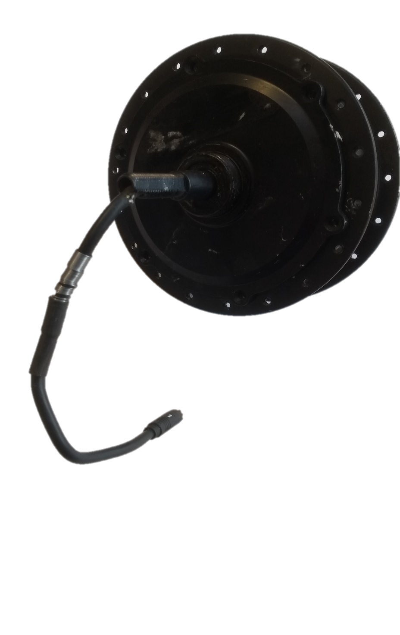
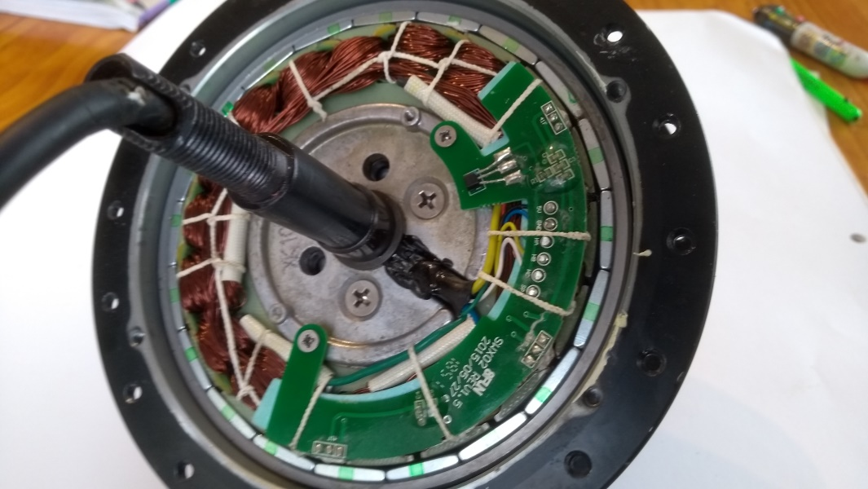
The Hub Motor
The hub motor is built into the centre of one of the wheels, usually the rear. It replaces the usual wheel hub, and has flanges around the outside rim with holes for the wheel spokes.
MeloYelo uses Permanent Magnet, Brushless, Geared hub motors

Slide 12
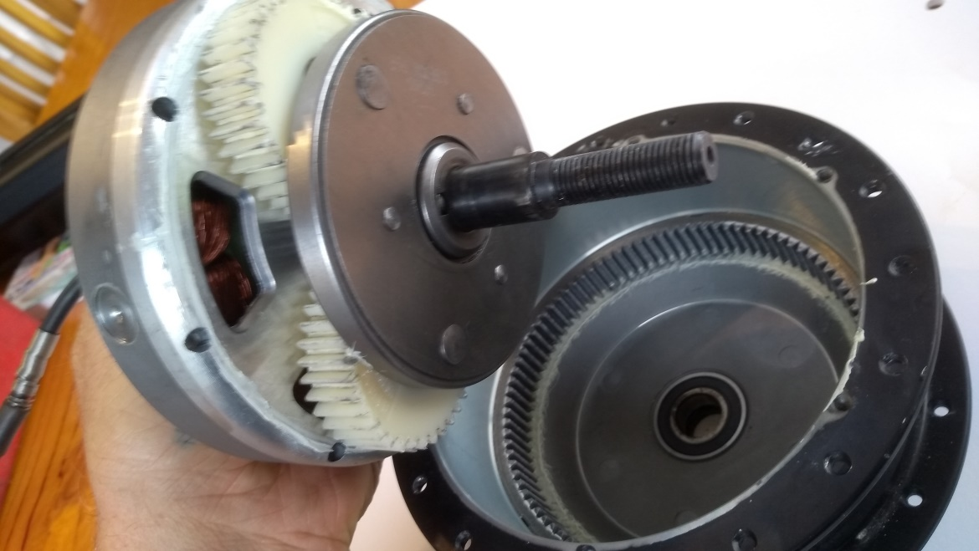
Motor Gearing
These Hub Motors have internal gearing, which allows the motor to spin much faster than the wheel. This allows a smaller, lighter motor to produce good power and torque at the wheel.
There is a freewheel built in so that the motor does not turn if coasting or pedalling without using motor power. This allows efficient pedalling with virtually no extra resistance caused by the motor.

Slide 13
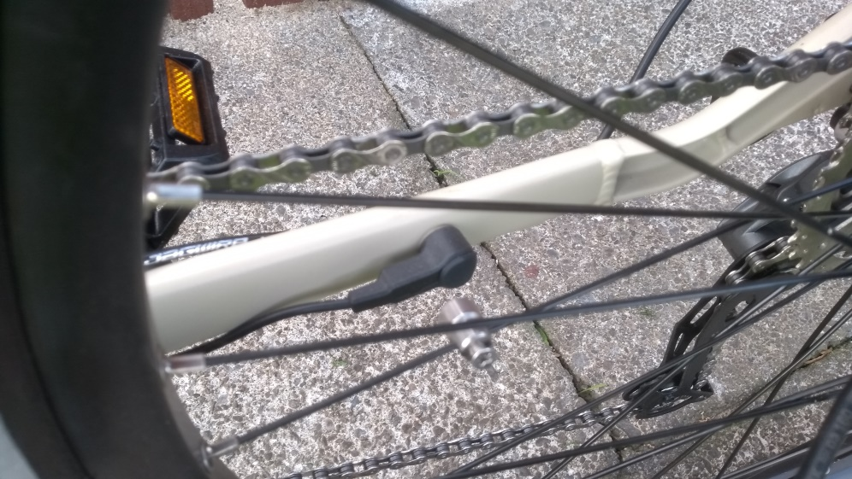
Speed Sensor
The controller needs to know what speed the bike is travelling at. A magnet rotating with the wheel passes a switch or hall sensor to send a pulse to the controller each time the wheel rotates. As the wheel size has been set in the controller, it can calculate speed from the time between pulses.
Most Hub Motors have the magnet and Hall Sensor built into the motor. Mid drive bikes and some others use a magnet on one of the wheel spokes and a switch on the frame of the bike.

Slide 14
Throttle
Some e-bikes do not have a throttle, but MeloYelo fits them to their bikes where possible. (June 2020, only the Tranzit cannot have a throttle). We use thumb lever throttles, fitted to the handlebar next to one of the handgrips.
The controller feeds 5Vdc to the throttle unit, and it returns a variable voltage signal between 1V (zero throttle) and 4V (full throttle).
Our controllers are programmed to give full power at full throttle regardless of which assistance level has been chosen (apart from assist level 0, when the throttle does not cause power to be applied).
We use Hall Effect throttles, where a magnet moves relative to a sensor, and the sensor outputs the variable voltage signal based on the strength of the magnetic field. These throttles are more reliable and less affected by water than other types such as potentiometers (variable resistors).
The controller can be programmed for “Speed” throttle (where 50% throttle causes the controller to try to drive the bike at 50% of the maximum speed set) or “Torque” throttle (where 50% throttle causes the controller to deliver 50% of the maximum motor current, giving 50% of maximum torque, regardless of speed. Both have advantages and disadvantages. Our bikes are delivered with “Speed” throttle, but can be reprogrammed for Torque.

